Slide 1
SAMSUNG
Hybrid Fan-out Solutions

Slide 2






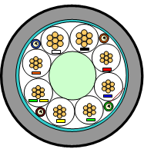
SAMSUNG’s Unique Solution
HFC CABLE
Solution : Hybrid Fan-out Cable
▪ Specialized Cable contains both optical fiber and power cable which
reduces installation time and real estate required
. 1 Cable covers 4 Radio Units ( Outer Diameter < 1 5/8 Inch )
. FO and power combined connector
1sector
VOC @ Customer
RU 4ea
2sector
RU 4ea
Reduce installation cost and time
- Easy and quick installation
Utilizes optical fiber for High Traffic and to Reduce opex associated with Real Estate
- combine 2 cables into one
. Optical Fiber + Power Cable
- Small cross-sectional area
3sector
RU 4ea
Dist. #1
Dist. #2
Dist. #3
Building
DU

Slide 3

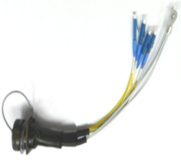
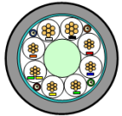
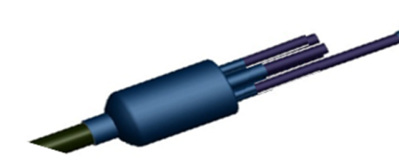
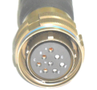
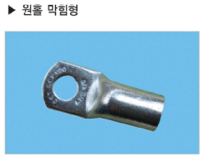
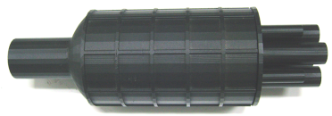
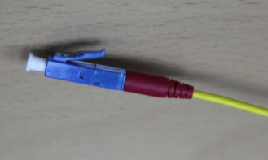
SAMSUNG’s Unique Solution
HFC CABLE
Solution : Hybrid Fan-out Cable
RRU
[Power Connector]
1 Hybrid Connector
- Fiber Optic
- Power
[LC connector ]
DU
Distribution Port
- Split to 4 RRU Connection Cable
- 1 HFC* -> 4 RRU Connections
- Water/Dust Proof (Comply IP-67)
*HFC : Hybrid Fan-out Cable

Slide 4
SAMSUNG’s Unique Solution
HFC CABLE
Solution : Hybrid Fan-out Cable
A
d(DU)
d(DU): Distance from DU to A
8~40 ft
DU
GROUP
0
RRU
14.3 “
GROUP
1
GROUP
2
d(Main Cable)
d(RRU)
100~400 ft
8~16.4 ft
GROUP
3
d(Cable): Distance from
A to Distribution Port
d(RRU): Distance from
Distribution Port to RRU
…
Power Connections
Fiber Optic Connections

